Slide 1


Web Development
Week 5
Abertay
abertay.ac.uk

Slide 2
This week's topics
Making planning documents
Managing multiple database tables
Perception and intro to accessibility

Slide 3
Navigation Flowchart
Abertay
abertay.ac.uk

Slide 4
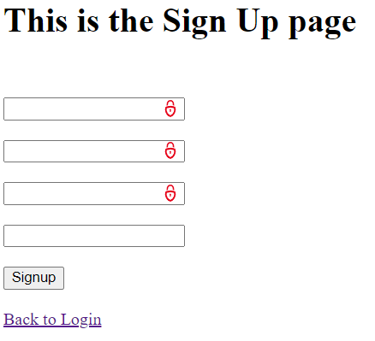
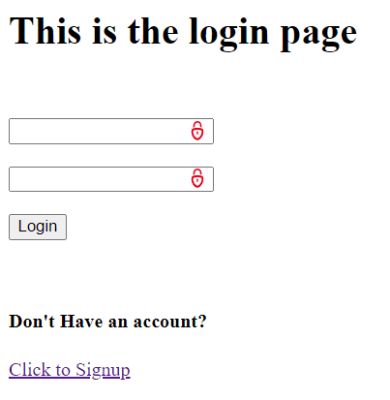
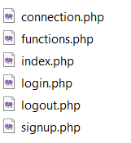
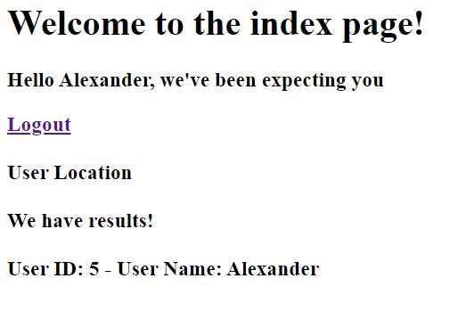
Our Login website

Slide 5
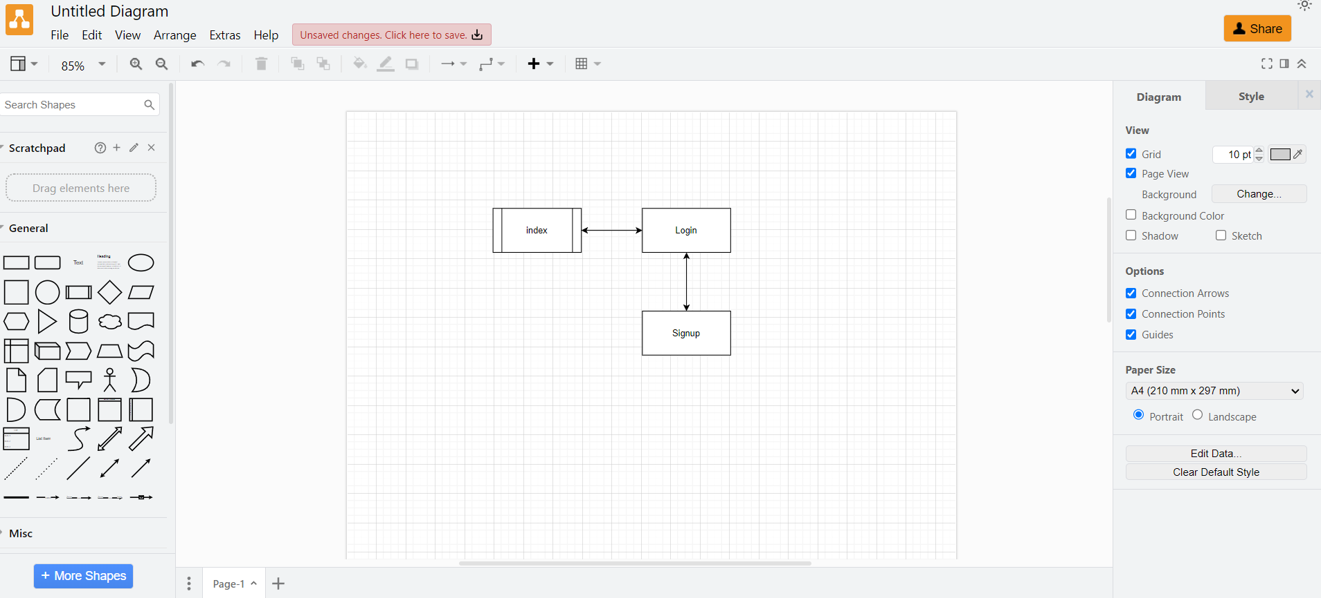
Navigation Flowchart
https://app.diagrams.net/

Slide 6
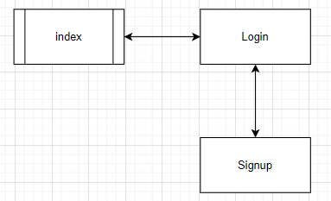
Navigation Flowchart
https://creately.com/diagram/example/jgq0dnuj1/website-navigation-flow-flowchart

Slide 7
Pseudocode
Abertay
abertay.ac.uk

Slide 8
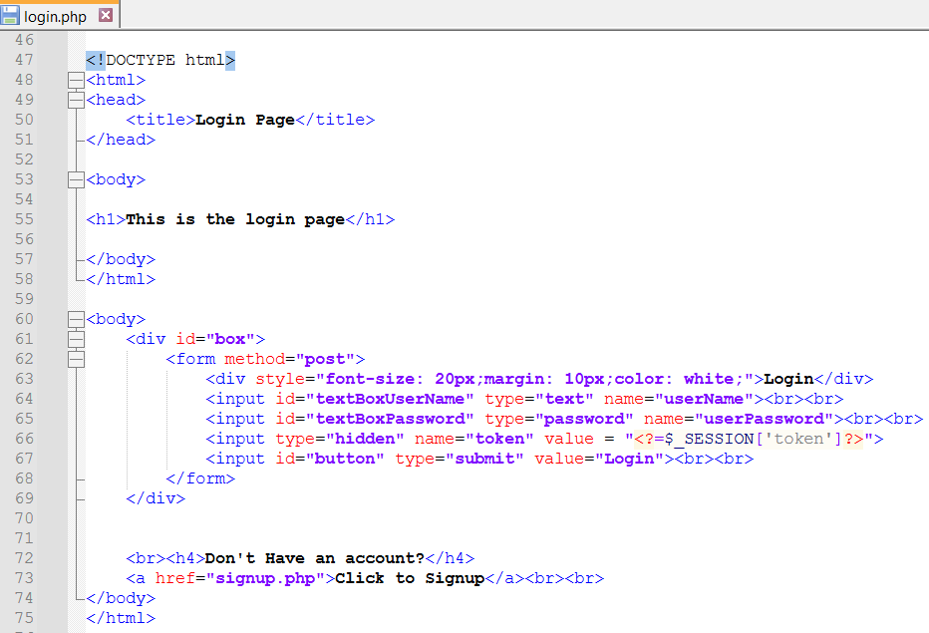
Pseudocode The Login Page

Slide 9
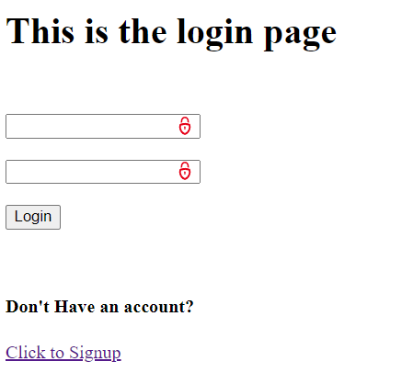
Pseudocode The Login Page
HTML content for login page:
- Title: "Login Page“
- Heading: "This is the login page“
- Login form:
* Input field for userName
* Password field for userPassword
* Hidden input field for ' CSRF token’
* Submit button labeled "Login“
- Link to signup page: "Don't Have an account? Click to Signup"

Slide 10
Pseudocode The Login Page
HTML content for login page:
- Title: "Login Page“
- Heading: "This is the login page“
- Login form:
* Input field for userName
* Password field for userPassword
* Hidden input field for ' CSRF token’
* Submit button labeled "Login“
- Link to signup page: "Don't Have an account? Click to Signup"

Slide 11
Start Session
Include connection.php
Include functions.php
IF request POSTED and 'token' is set AND 'token’ valid THEN
Initialize userName with POSTED['userName']
IF userName AND userPassword are not empty AND userName not numeric THEN
Prepare SQL query to select user record from 'Users' table where userNames match
Bind posted userName to the prepared SQL query
IF SQL query is successful THEN
Retrieve the resulting user record
IF user data is found THEN
Verify the provided password with the hashed password in the database
IF password is correct THEN
Set user session with user's ID
Redirect to index.php
Terminate script execution
END IF
ELSE
Display "wrong username or password!"
END IF
END IF
ELSE
Display "wrong username or password!"
END IF
END IF
Generate a new token for the form (anti-CSRF measure)
Pseudocode The Login Page

Slide 12
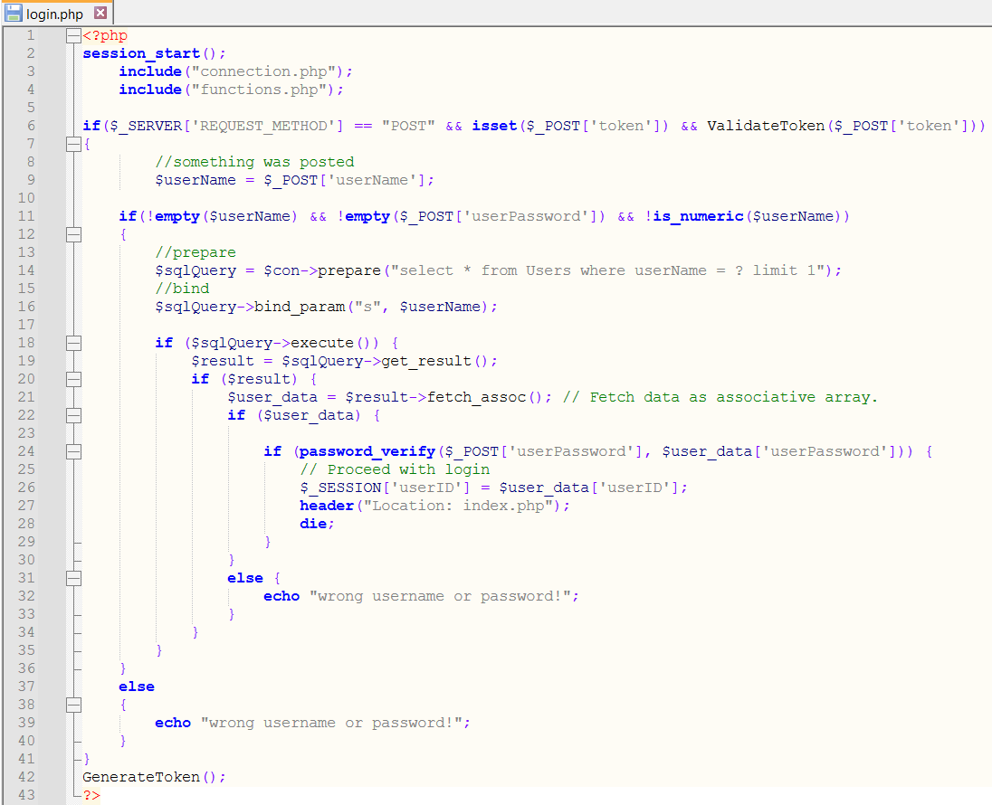
Pseudocode The Login Page

Slide 13

Pseudocode
https://www.geeksforgeeks.org/what-is-pseudocode-a-complete-tutorial/

Slide 14
Multiple Tables in a Database
Abertay
abertay.ac.uk

Slide 15
Multiple Tables
OrderedItems
orderID
itemID
quantity
Orders
userID
orderID
orderDate
orderStatus
deliveryAddress
totalCost
Users
userID
userRank
userEmail
userPassword
userJoiningDate
Items
itemID
itemName
itemImage
itemCost

Slide 16
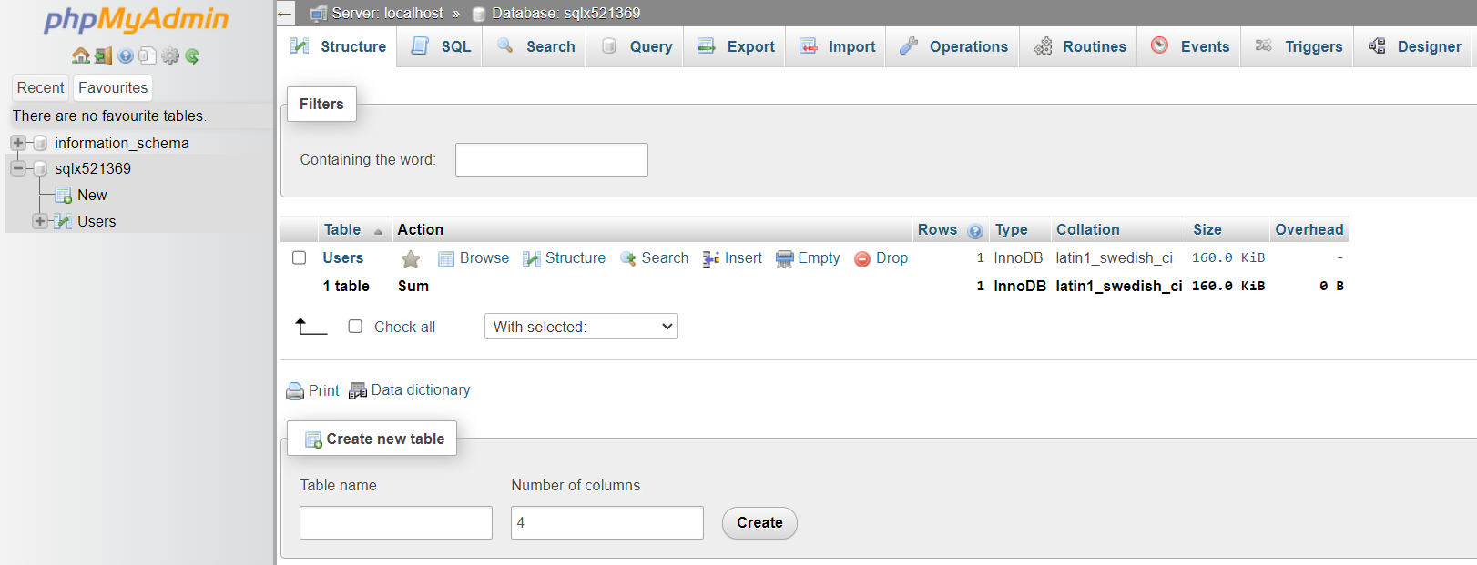
Multiple Tables

Slide 17
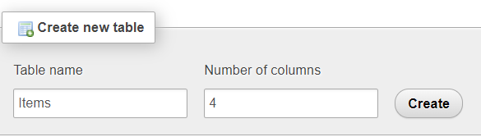
Multiple Tables

Slide 18
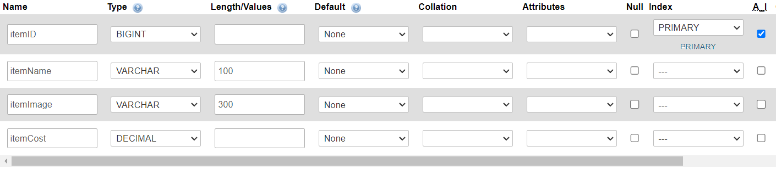
Multiple Tables

Slide 19
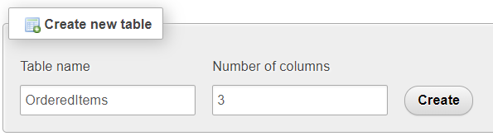
Multiple Tables

Slide 20
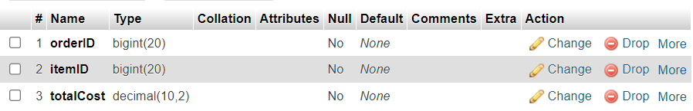
Multiple Tables
This should be quantity and should be an integer

Slide 21
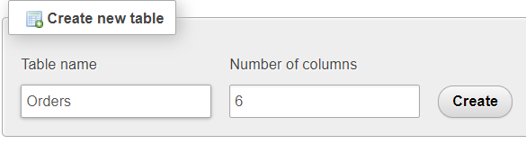
Multiple Tables

Slide 22
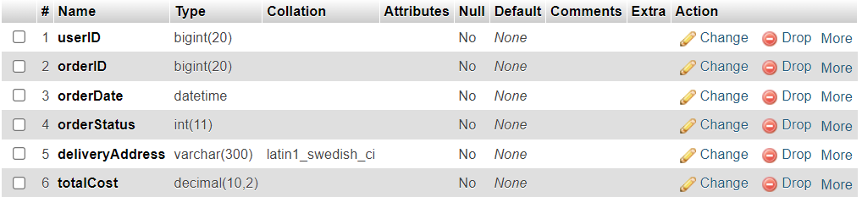
Multiple Tables

Slide 23
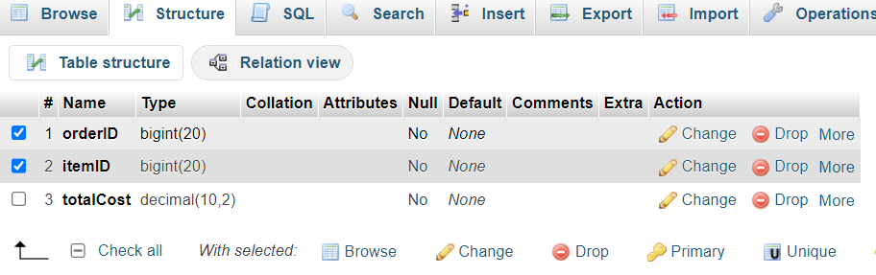
Compound Keys

Slide 24
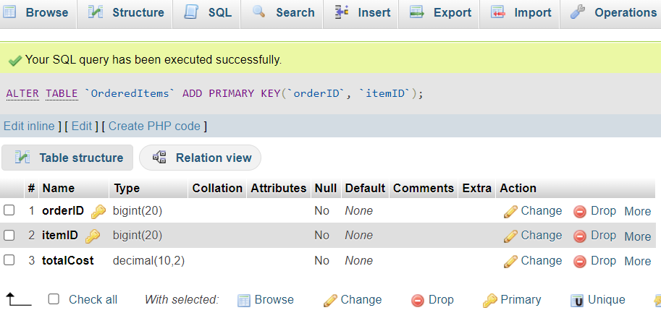
Compound Keys

Slide 25
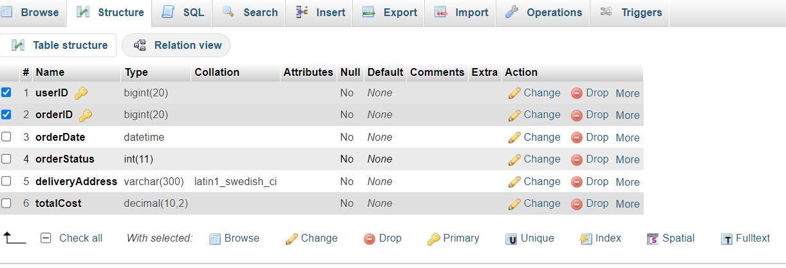
Compound Keys

Slide 26
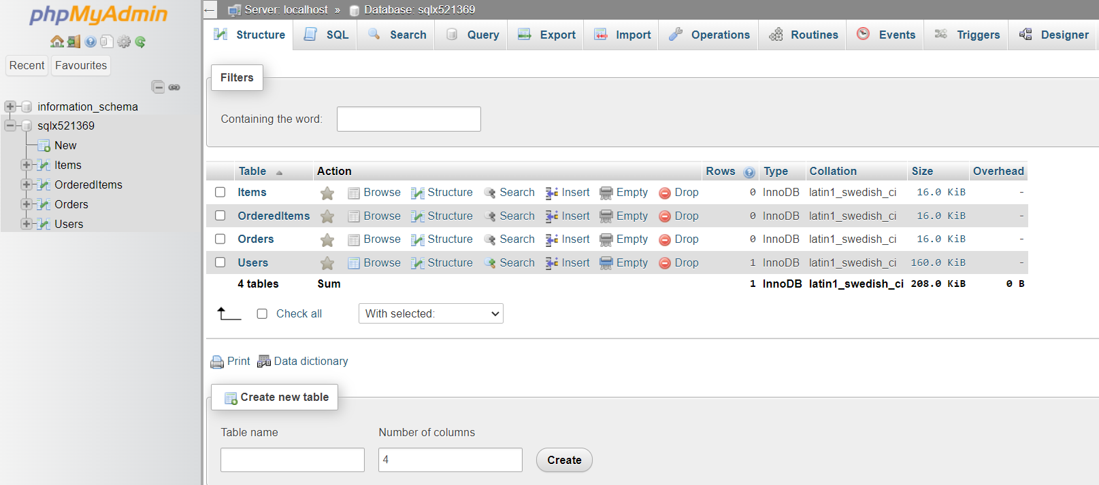
Relationships Between Tables

Slide 27
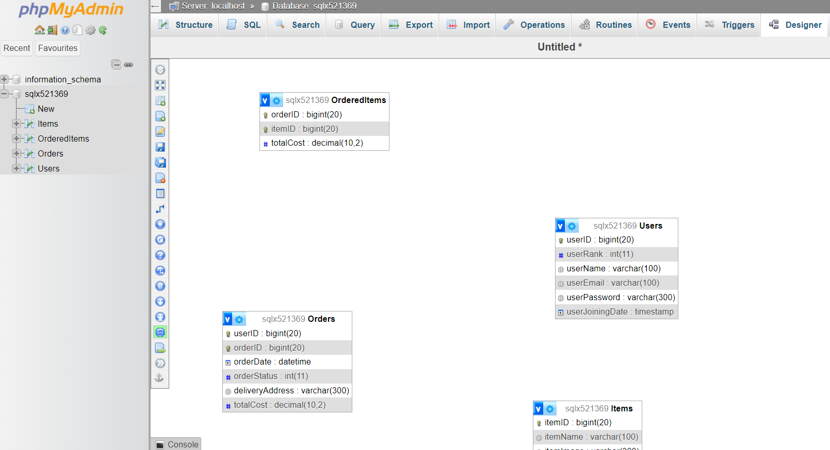
Relationships Between Tables

Slide 28
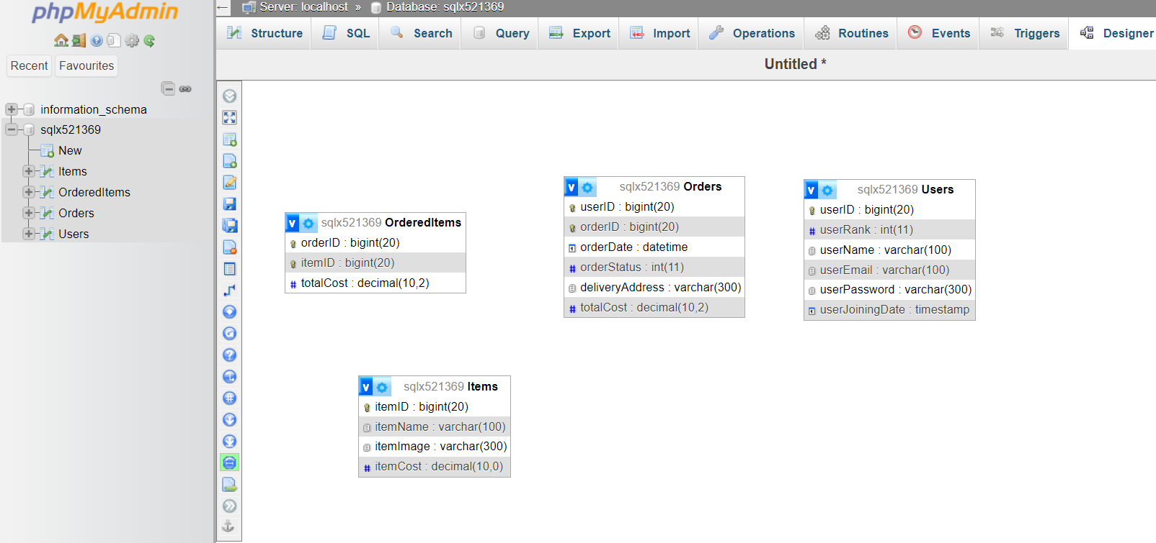
Relationships Between Tables

Slide 29
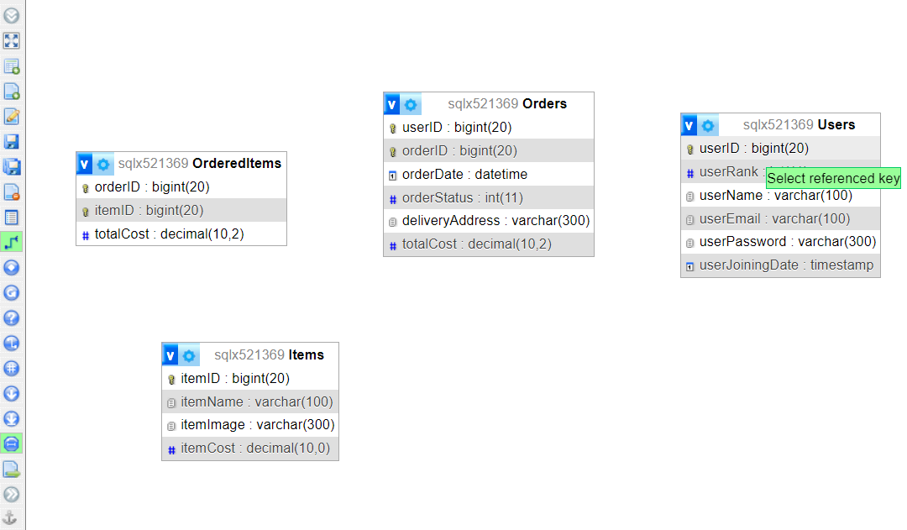
Relationships Between Tables

Slide 30
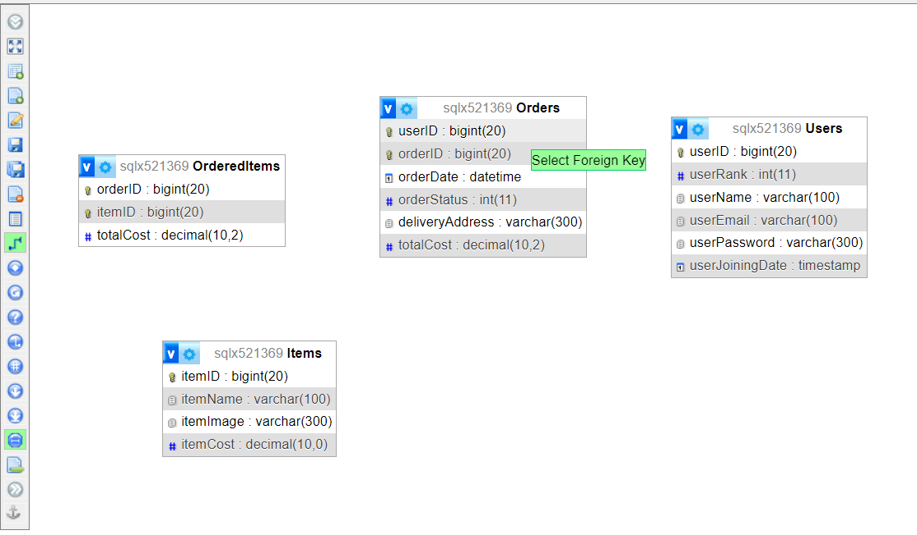
Relationships Between Tables

Slide 31
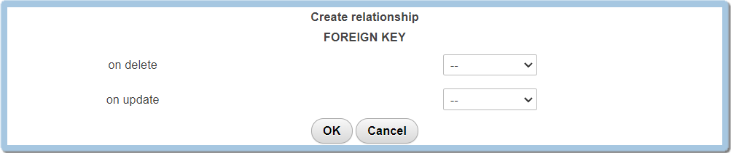
Relationships Between Tables

Slide 32
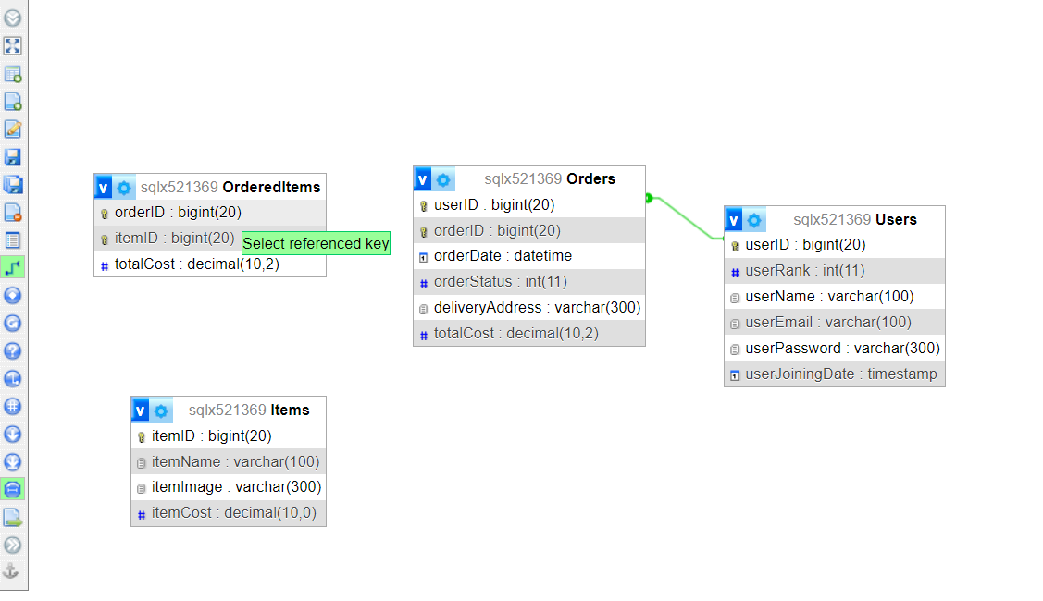
Relationships Between Tables

Slide 33
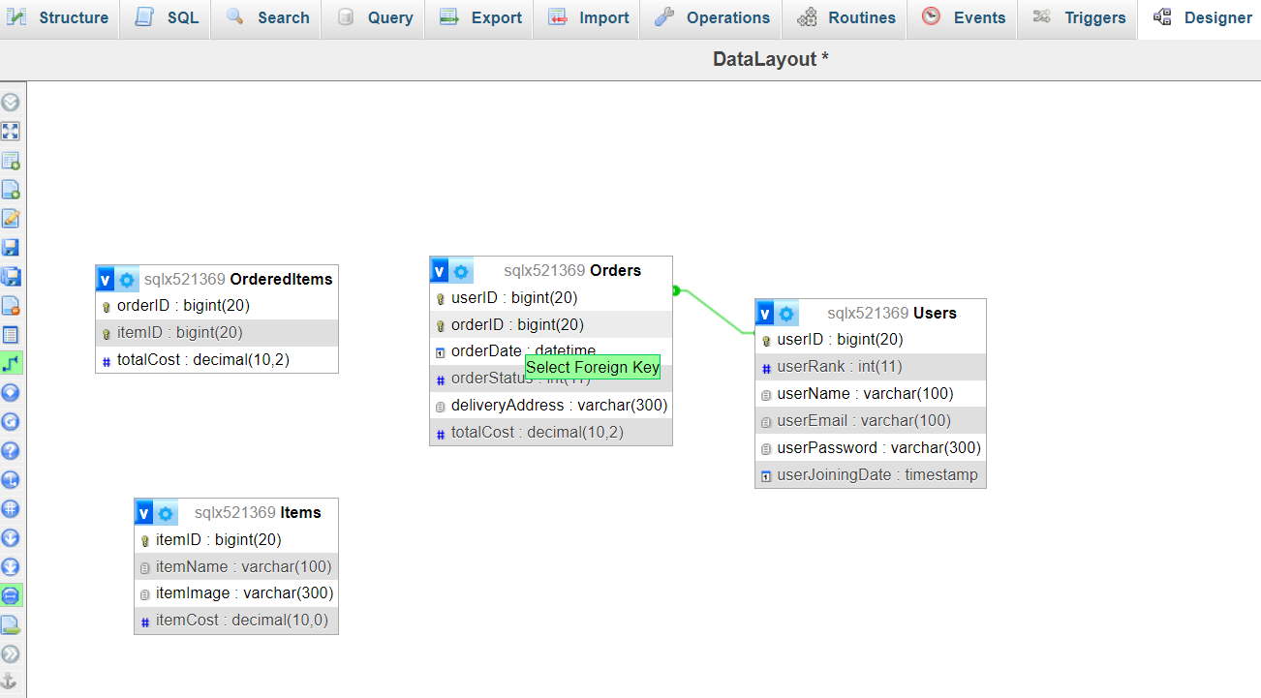
Relationships Between Tables

Slide 34
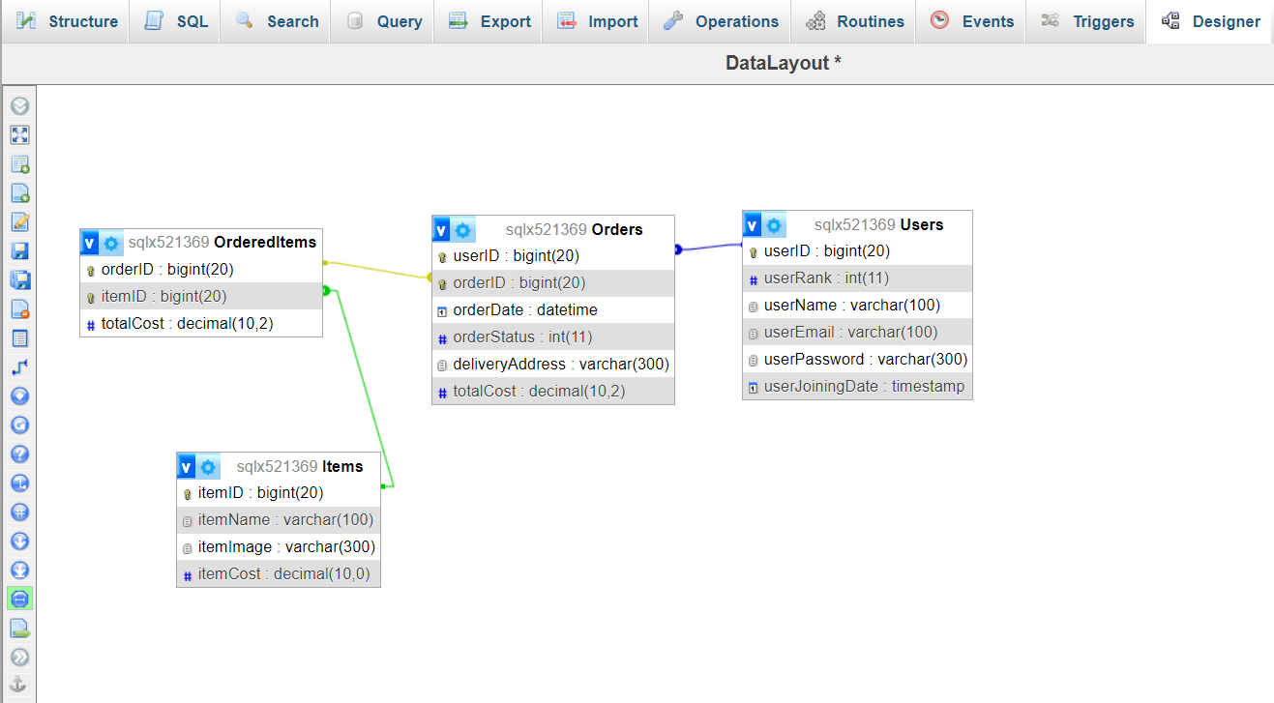
Relationships Between Tables
https://www.w3schools.com/sql/sql_foreignkey.asp
https://www.geeksforgeeks.org/composite-key-in-sql/

Slide 35
Simple Database Schema
Abertay
abertay.ac.uk

Slide 36
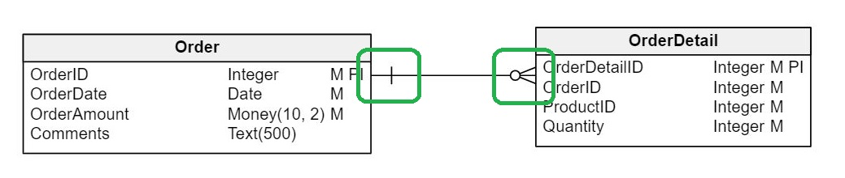
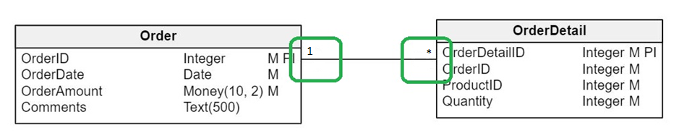
Database Schema
Table Relationships
One to Many relationships

Slide 37
Relationships Between Tables
OrderedItems
orderID
itemID
quantity
*
Orders
userID
orderID
orderDate
orderStatus
deliveryAddress
totalCost
Users
userID
userRank
userEmail
userPassword
userJoiningDate
*
*
1
1
Items
itemID
itemName
itemImage
itemCost
1

Slide 38
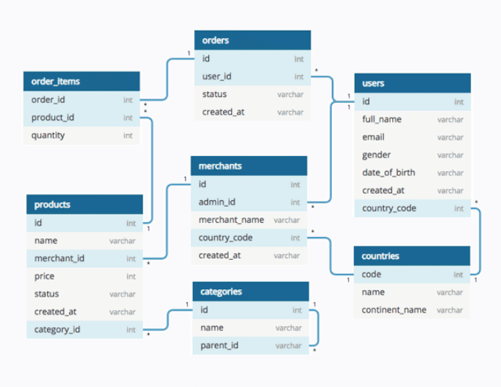
Database Schema
https://www.geeksforgeeks.org/database-schemas/

Slide 39
Perception
Abertay
abertay.ac.uk

Slide 40

Perception

Slide 41
Perception
A saccade is a rapid eye movement that shifts the centre of gaze from one part of the visual field to another
Even when we are attempting to fix our gaze, our eyes make tiny saccades to collect information
What we “see” as a complete picture is the result of the brain processing the tiny images and putting them together

Slide 42
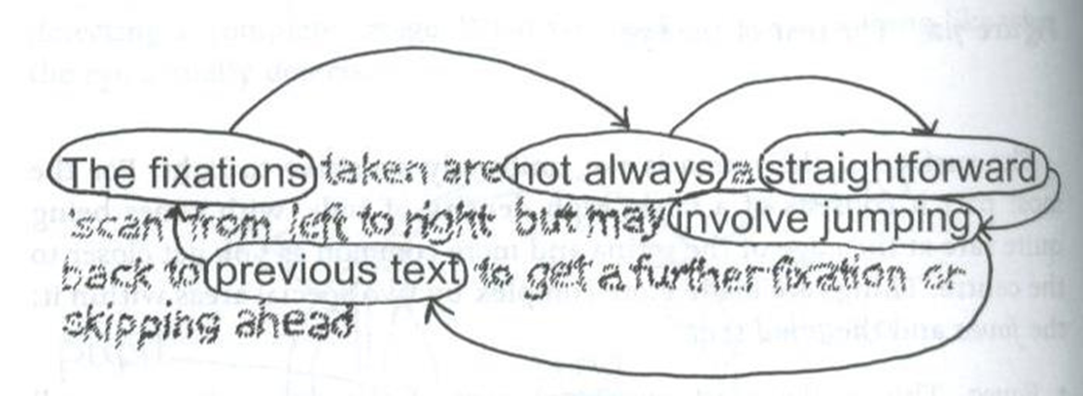
Perception

Slide 43
Perception
The Fixations and not always a straightforward
‘scan from left to right but may involve jumping back to previous text to get a further fixation or skipping ahead

Slide 44


Slide 45
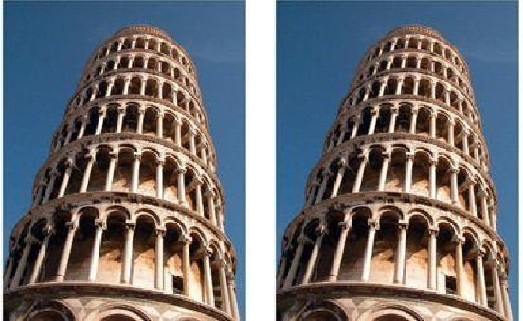
Illusion

Slide 46
Illusion
The images are identical, but the tower on the right appears to lean more because the human visual system treats the two images as one scene. Our brains are conditioned to expect parallel towers to converge toward a common vanishing point, but because the tower on the right does not converge, our visual system interprets that it is leaning at a different angle.

Slide 47

Illusion

Slide 48

Illusion

Slide 49
Illusion
The center dot in each square is the same shade. The shade of the background influences how we perceive it. All squares are uniformly shaded, but each square seems lighter on its left edge than on its right edge

Slide 50

Illusion

Slide 51
Illusion

Slide 52
Illusion

Slide 53
Illusion

Slide 54
Accessibility
Abertay
abertay.ac.uk

Slide 55

The World Wide Web Consortium
(W3C)
The W3C is an international organization who develop Web standards for:
Accessibility,
Internationalization,
Privacy,
and Security.

Slide 56
Web Content Accessibility Guidelines
(WCAG)
WCAG documents explain how to make web content accessible
W3C WCAG
GOV.uk WCAG

Slide 57
Accessibility in Web Development
W3C Accessibility Fundamentals
W3C Tools and Evaluation
W3C Easy Checks

Slide 58
Next Week’s Topics?
Un-Accessible Websites
Accessibility for colour blindness and others
Using Multiple Database Tables in a Website
Abertay
abertay.ac.uk

Slide 59
Questions?
Abertay
abertay.ac.uk

